Slide 1
Case Study in Transformation: Strategic Planning, Leadership and Collaboration
Thomas Wilds & Genni Sasnett Subject Matter Experts

Slide 2
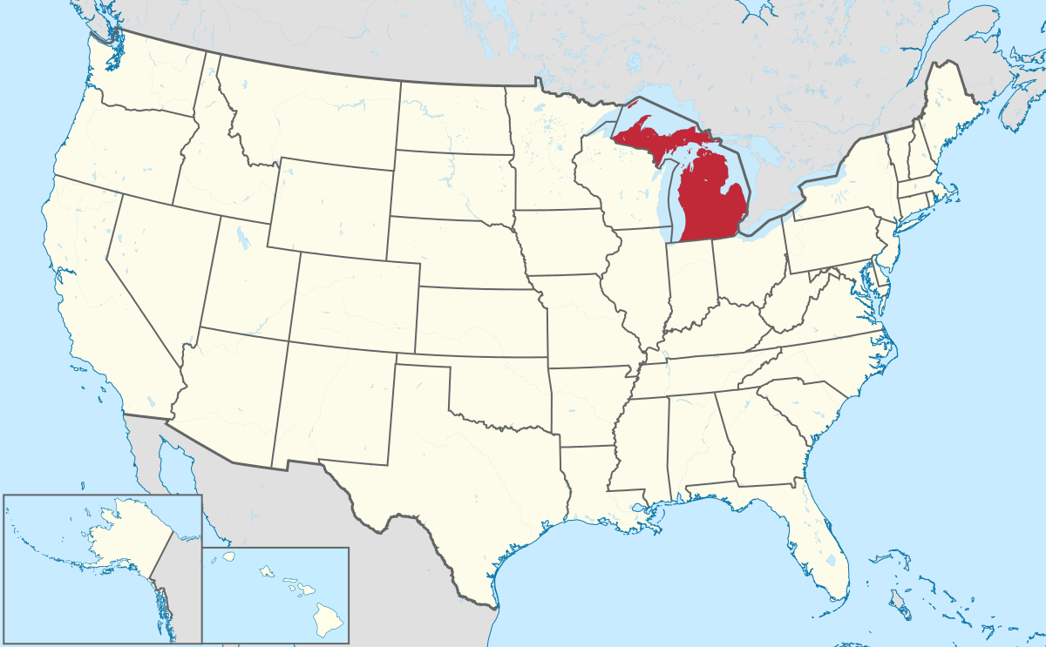
Michigan Provider Transformation Project Agency: Serves people primarily in Lapeer County, Michigan City population was 8,841. County population 88,319 Supports 180 individuals living with disabilities

Slide 3
Overview
The agency has evolved from a large local institution to an ARC program to an employment focused agency
Not-for-profit community rehabilitation organization
CARF certified
Employment skills focus for people living with disabilities ages 16 and older
Nearly all supported are in a semi-segregated employment setting (center & community) Subminimal Wage Certificate 14C
No formal community experience program
Converting to Managed Care- Each region rates are different
Leadership in transition

Slide 4
Mobile Work Crew
The Mobile Work Crew Program provides custodial and other services in over twenty local businesses and organizations in the region.
The focus is to assist consumers in developing work skills and work practices that prepare consumers for competitive employment but few are ever placed at jobs outside the agency
For most this was considered as a final employment placement
The agency pays crew directly rather than from the contracting business

Slide 5
Employment Placement Services
Voc. Rehab. Provider (Center-based services)
Job Readiness Training: We focus on barriers to employment and discuss the coping mechanisms and tools available to help overcome those barriers.
Best Impression Classes: Participants learn how to dress for interviews, interviewing etiquette, and tips on personal hygiene.
Job Seeking Training: Participants obtain the tools needed to look for a job and how to find gainful employment. Learn how to complete job applications, write a resume and cover letter, and discuss various interviewing techniques, personal presentation styles, and how to prepare follow up thank you letters.
Work Experience/Evaluation: This program is typically 2 weeks. They asses skills, abilities and barriers to employment.

Slide 6
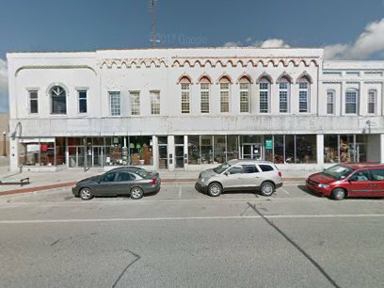
Retail Training (New To You Consignment)
Retail training at Consignment offers a growing business service for County. Consumers gain new skills including: customer service, internet research for pricing, and preparing apparel for sale. “Consignment” offers a place of employment to gain skills and experience.

Slide 7
Workshop (14C)
Has been serving individuals with disabilities in and around Lapeer County for over 50 years.
Markets quality contract work at reasonable prices to manufacturing companies throughout Michigan. It also employees people not having disabilities from the community as a routine practice.
An example is their golf ball recycling service. Balls reclaimed from water hazards are sorted, reconditioned, cleaned and packaged for resale.
Its programs enhance abilities in the areas of self-help, occupational, communication, socialization and most recently mobility and living skills.
Considered as a final employment placement

Slide 8
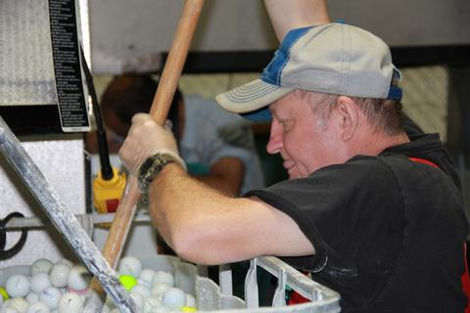
Workshop

Slide 9
Employment First The Technical Assistance Process
Agency Team Self Assessment (ODEP Tool)
Agency Site Visit by SME
SME Recommendations Report
Negotiated & Finalized Recommendations
Team Prioritized Recommendations
Team developed Implementation Plan
Plan Implemented & Continued Reassessment

Slide 10
Assessment & Plan Components Criteria for Performance Excellence in Provider Transformation
Leadership
Strategic Planning
Customer Focus
Workforce Focus
Operations Focus
Measurement, Analysis & Knowledge Management
Results

Slide 11
Core Values/ Team Planning Example
Activity | Responsible | Timeframe | Resources | Comments
1.) Develop the planning team | CEO/COO/CFO HR/Prog Managers | May 1 | Reg schedule senior meeting
2.)review mission, vision, core values | Management team | May 15 | Reg. Schedule team meeting
3.) Schedule focus groups to explore core values. Divide into groups | Prog Managers, staff, Participants, families, board members | June 15 | Consultants Small conf room
4.) Large group meeting, consolidate value statements/draft document for group review | Invite previous participants | July 15 | Large conf room
intermediate – evaluate finance

Slide 13
Leadership- Progress
The Board and leadership team are very supportive of the Employment First Transformation process after Transformation training
COO in transition to CEO/COO leading transformation effort
Working on new 2-year Strategic Plan
The board passed a resolution to sell the GO Industries manufacturing building, where contracted workshop activities take place.
A series of presentations regarding the sale of the workshop building and plans to transform services were provided to parents, board and staff members, and leadership
Developing a Communication Plan: Working on website redesign to emphasize an Employment Fist focus, redesigning all print marketing materials, reached out to all families and update contact information. Tracking all community resources.

Slide 14
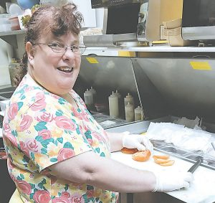
The County Press MaryAnn D. exploring the world of food service with the help of our community partners Nickol and Sam from Dagwood’s/Blondies
Lapeer Team Work, Inc.
525 S. Court St., Lapeer • 810-664-8504 • www.lapeerteamwork.com 286 W. Nepessing St., Suite 2, Lapeer • 810-664-2710 MARCH 03, 2019
LAPEER — The exciting changes to Lapeer Team Work (LTW) are all-encompassing as we move into the next chapter for our agency. We are experiencing exponential growth and an increase in opportunities to those that we serve.
In order to stay ahead of the curve, maintain the integrity of our mission and maximize potential, we are modifying our current service delivery model. While our current model lends itself to providing quality vocational training services to individuals with disabilities, we are challenged to weave our services more tightly into our community to foster a more inclusive environment for all.
Our highly qualified and trained team will be moving our services into the greater community, allowing the individuals that we support to fully explore the world of work around them. Since the new model of service delivery discourages a facility-based setting, we are selling our Court Street location. The change to community integration was received with open arms when we approached the manufacturing companies that we currently perform assembly and sorting work for at our Court Street location. Companies are embracing the change in contract to performing our services at their location and are delighted to have the individuals that we serve perform the work on-site with supports.
Simultaneously, our downtown location will undergo a substantial facelift. With the award of a Michigan Economic Development Corporation grant, the renovations will begin soon. The LTW building will receive a new façade, roof, and five additional apartments. The apartments are projected to be equipped with an elevator, making them more accessible. Before long, LTW will have a newly renovated home in downtown Lapeer, along with a rejuvenated service delivery model that will enhance the lives of the individuals that we serve, our staff and our community.
If you or a business owner you know are interested in assisting our agency in providing greater opportunity through vocation and the exploration of the world of work to individuals with disabilities, please reach out to Breanne Heron, LTW Business Manager, at 810- 664-2710

Slide 15
Leadership-Next Steps
Complete 2 Year Strategic Plan
Complete Communication Plan including a photo library of community inclusion activities and success stories
Work with referral sources to increase referrals
Continue to educate Members of the Board and leadership and report progress data
Continue succession planning for leadership transition
This Photo by Unknown Author is licensed under CC BY-SA

Slide 16
Operations Focus- Progress
Exploring transportation alternatives with local car dealership
Reviewing service data base programs
Attempting to re-envision a workshop program (golf ball recycling) that includes selling building and moving employees to contractor’s payroll. When the GO Industries building sells, resources will be redirected to community-based services and supports.
Developed min. wage contract with Medical Center moving workshop participants to a community-based setting and increasing community employment opportunities
Negotiating a new fee schedules with referring agencies to foster financial stability for community-based services and outcome-based incentives
Implementation of weekly community exploration and discovery activity schedules (group & individual) as well as routine data collection forms

Slide 17
Operations Focus- Progress2
The agency has sound separate budgets for each service
Agency has created a strong partnership with the local Community Mental Health agency including a part time assignment to provide employment service coordination, assessments, and employment goal development and support
The agency plans to allow their Subminimum Wage 14C Certificate to expire
Participants have exponentially increased time in community-based activities and has expanded placement services with new staff
Anticipating the addition of another job placement staff
Agency transitioned individuals to supportive employment services, decreasing in-house skill building services
The agency has four divisions: assembly, retail, mobile crews and employment placement. The latter is a new service and now draws on the first three training opportunities. Ending the practice of using the first three “training” experiences as final placements

Slide 18
Operations Focus-Next Steps
Discontinue the 14C certificate
Continue to expand the types of community experiences available to participants (Volunteer, educational & recreational)
Complete sale of the facility-based manufacturing building
Promote direct employment of all work crews by community work sites
Make the 3 training services under Employment Services-time limited
Center-based skill building experiences-move to community
Lease additional smaller vehicles/being reimbursed mileage/use local dealership/downsize and personalize transportation
Take on additional referral sources -local rehab. And private insurance. Rely less on Medicaid & more VR, school-age transition w VR
Continue to increase supported and customized employment placements, collect data and report progress

Slide 19
Human Resources Focus-Progress
The COO has achieved ACRE train-the-trainer certification, obtained customized employment training, and participated in a Train the Trainer Session for Family Engagement
Employment placement staff achieved the ACRE Certificate, Employment Specialist Certificate, and Benefits to Work Coach training
A national Subject Matter Expert (SME) provided Customized Employment training to facilitate job development and placement for people with more complex disabilities
Hired a new job placement specialist

Slide 20
Human Resources Focus-Next Steps
Implement higher staff ratios in community-based services
Secure job coach and customized employment training for all direct service staff
COO will be an ACRE trainer
COO is participating in MARO’s Leadership Academy that aims to prepare future leaders with training in such areas as finance, accounting, board governance, etc.; projected graduation in June 2019
Move forward with the anticipated addition of another job placement staff

Slide 21
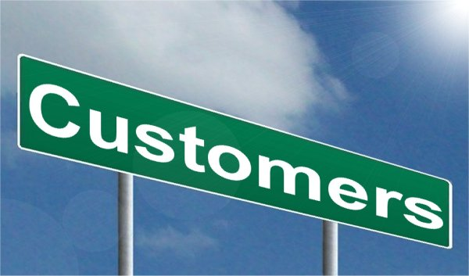
Customer Focus-Progress
Working with parents to prepare them for the agency’s improved community-based service delivery model and the expiration of the subminimum wage certificate
Increase from 5 to 25 Supported Employment participants in the last few months
Connecting with current manufacturing and janitorial customers to pave the way for opportunities within their businesses
Implement individual and group community-base planning and data collection (3) forms and share progress with parents

Slide 22
Customer Focus-next steps
Work with parents and participants through the Communication Plan to continue to educate them about Employment First, Settings Rule, benefits counseling resources, and other topics that concern them
Use parent training materials in future parent meetings and to train direct support staff on how to best engage with families, creating positive dialogue surrounding employment
Implement weekly community schedules (group and individual) as well as routine data collection forms that reflect Person Centered Planning
This Photo by Unknown Author is licensed under CC BY-SA

Slide 23
Data Management & Quality Assurance-Progress
Technology-added 4 tablets/computers-in field
Software-CMH allows agency to use their software & data base
The agency has been CARF recertified
This Photo by Unknown Author is licensed under CC BY-NC

Slide 24
Data Management & Quality Assurance-Next Steps
Continue to increase lap top computers availability for in-field staff
Implement specific quality standards for job placement staff including a 65-70% placement rate as well as expected time frames from date of referral to placement date.
Develop electronic tracking data base for all participants from referral to employment placements (time through ea. step of process, wages, benefits, positions, preferences, skills, etc.)
Continue to monitor each service’s financial status, income, and expenses monthly and report to the leadership and board
Create data tracking for areas needing monitoring or decisions,
Document agency’s journey through the Transformation process, e.g., power point presentations, board summaries, participant success stories, etc., and plan to share at state and national venues (incorporate in Strategic Plan).
Work towards analyzing the service costs for rate negotiating

Slide 25
Essential Tools for Transformation
A community-based mission
Leadership embracing it
A commitment to team planning & problem solving
Collaboration with government, businesses & other community resources
This Photo by Unknown Author is licensed under CC BY-NC

Slide 26
Questions, Comments, Ideas

Slide 27
Group Discussion 1
What do you take away
from the Michigan example?

Slide 28
Group Discussion 2
What are the effective strategic steps your agency has or will take to position your agency for Transformation?
This Photo by Unknown Author is licensed under CC BY

Slide 29
Group Discussion 3
What would be the challenges your agency will face moving toward Transformation?

Slide 30
Group Discussion 4
How have or will you be
obtaining input?
Are you already doing this? From whom?
& providing education to key stakeholders? How?

Slide 31
Group Discussion 5
What are ways you can collaborate with other providers?
& collaborate with community partners to support your transformation efforts?

